Slide 1
Entering the next phase of EOSC
Rupert Lueck
EOSC EB, Co-Chair WG Sustainability
PaNOSC and ExPaNDS Symposium 9th November 2020

Slide 2
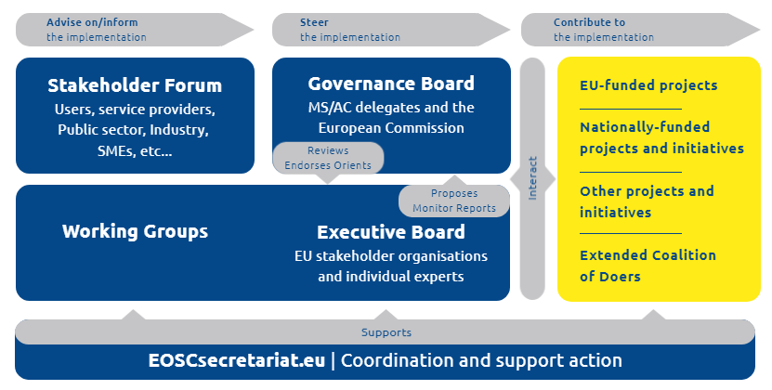
EOSC governance is transitioning
Current governance structure until 31 December 2020
New EOSC European Partnership
Strategy Committee MS/AC
European Commission
EOSC Association
Partnership Board
(EC, Board & Strategy Committee)
General Assembly
Board
President
MoU
Secretary General
Commission funding through work programme
Contributions by MS / AC and others (in kind; data, services, …)
Join the EOSC Association to influence future directions

Slide 3
EOSC Partnership: EOSC Association and SRIA
EOSC Association to sign the MoU with the EC in January 2021
Officially founded in July 2020
CAESAER, CSIC, GÉANT and GARR as founding members
Initial set of 139 members and 48 observers provisionally accepted
1st General Assembly 17 December 2020
Strategic Research an Innovation Agenda (SRIA) will be annexed to the MoU
Stakeholder consultation over the summer
Version 0.8 was made available during the EOSC Symposium: https://www.eoscsecretariat.eu/news-opinion/eosc-strategic-research-and-innovation-agenda-version-08
Version 0.9 will be submitted to the EOSC GB on 13th November
Version 1.0 in early December

Slide 4
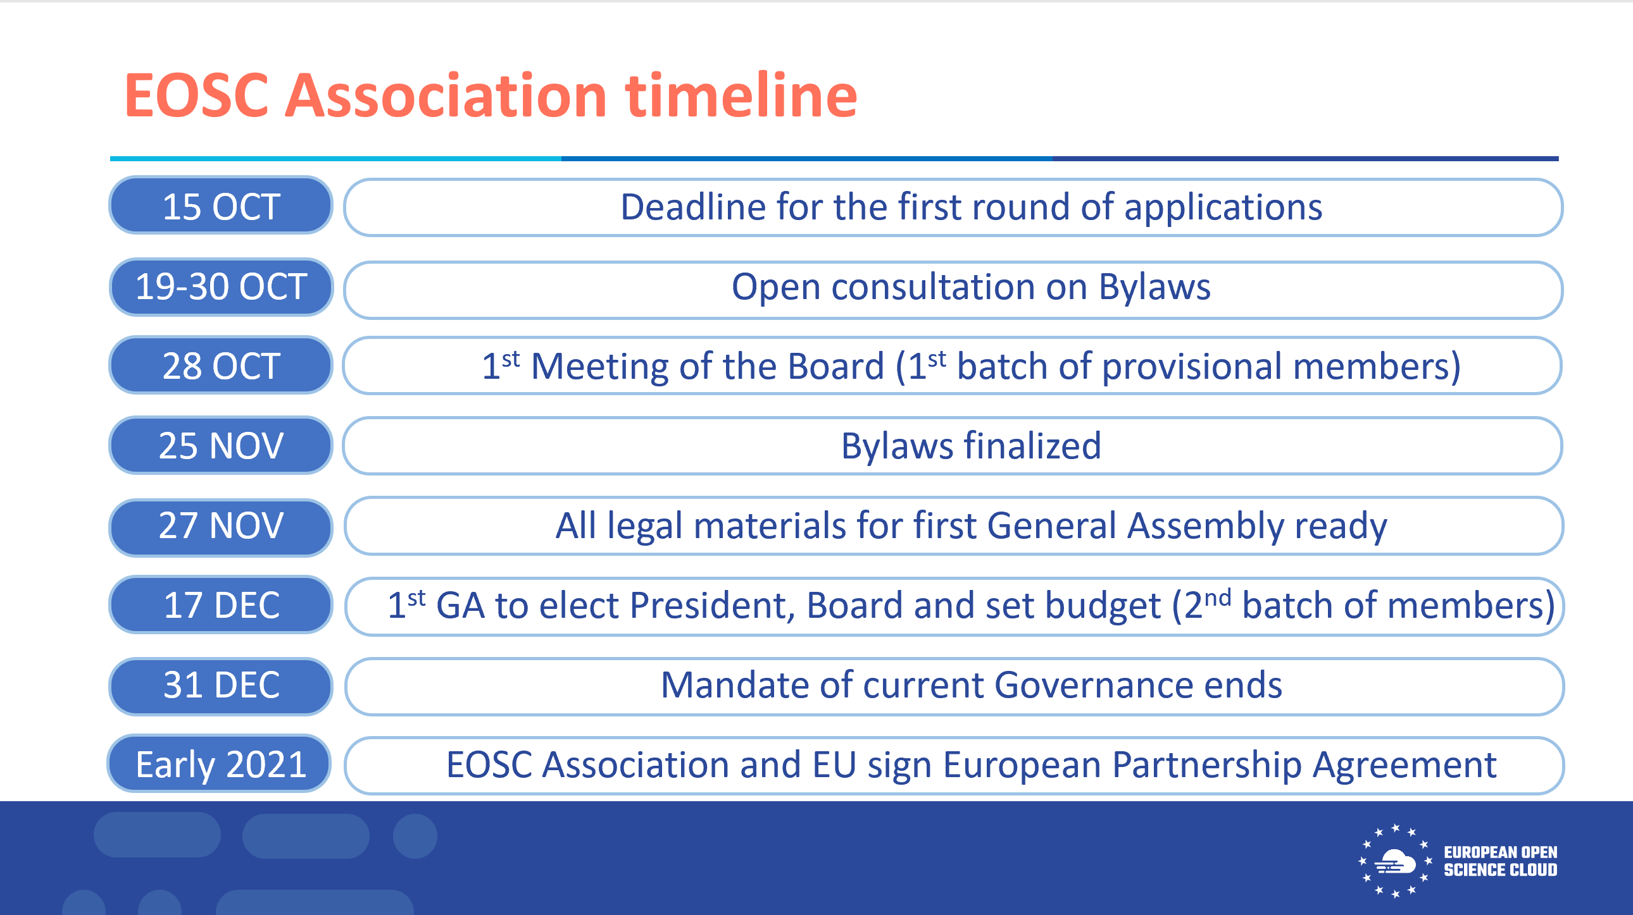
0

Slide 5
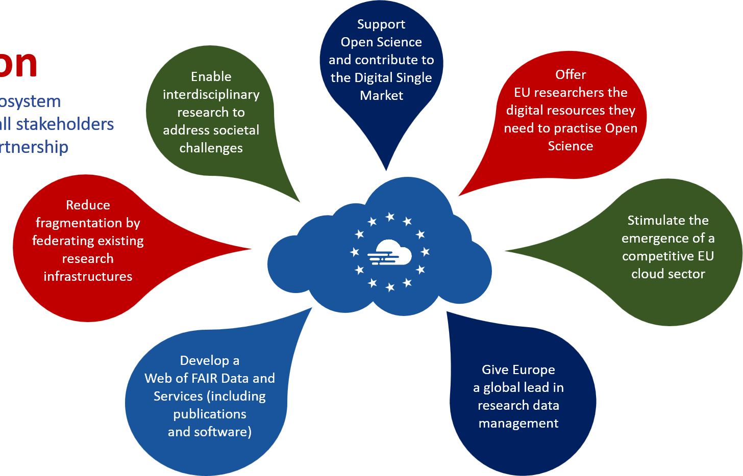
Why should I join?
The Vision Building the EOSC ecosystem collaboratively with all the stakeholders through the EOSC Partnership
The Impact
Via the Strategic Research and Innovation Agenda (SRIA), every organisation can influence the future direction of EOSC!

Slide 6



WHAT
WHY
Co-Chairs Rupert Lueck Lidia Borrell-Damián EMBL Science Europe
Provide strategic, legal and financing recommendations for an operational, scalable and sustainable EOSC federation after 2020
A clear understanding of key strategic, financial and legal aspects is essential for the second phase of the EOSC implementation
Towards a sustainable EOSC
HOW
Analyse business models and implications on legal entity, costs, regulations, financial strategies, supporting NDI alignment
Map potential legal entities, taking into account national and European legislation
Examine options for a governance framework to oversee EOSC operations and development
Analyse regulatory/policy environments and assess impact of proposed structures and funding streams at national & European level
Q1 2020 Initial analysis of alternative business model scenarios and potential future legal models
Q2 2020 Refined business model options and future legal models
Q3 2020 Recommendations on strategic and financing orientations and organisational settings for the future of the EOSC, post 2020

Slide 7
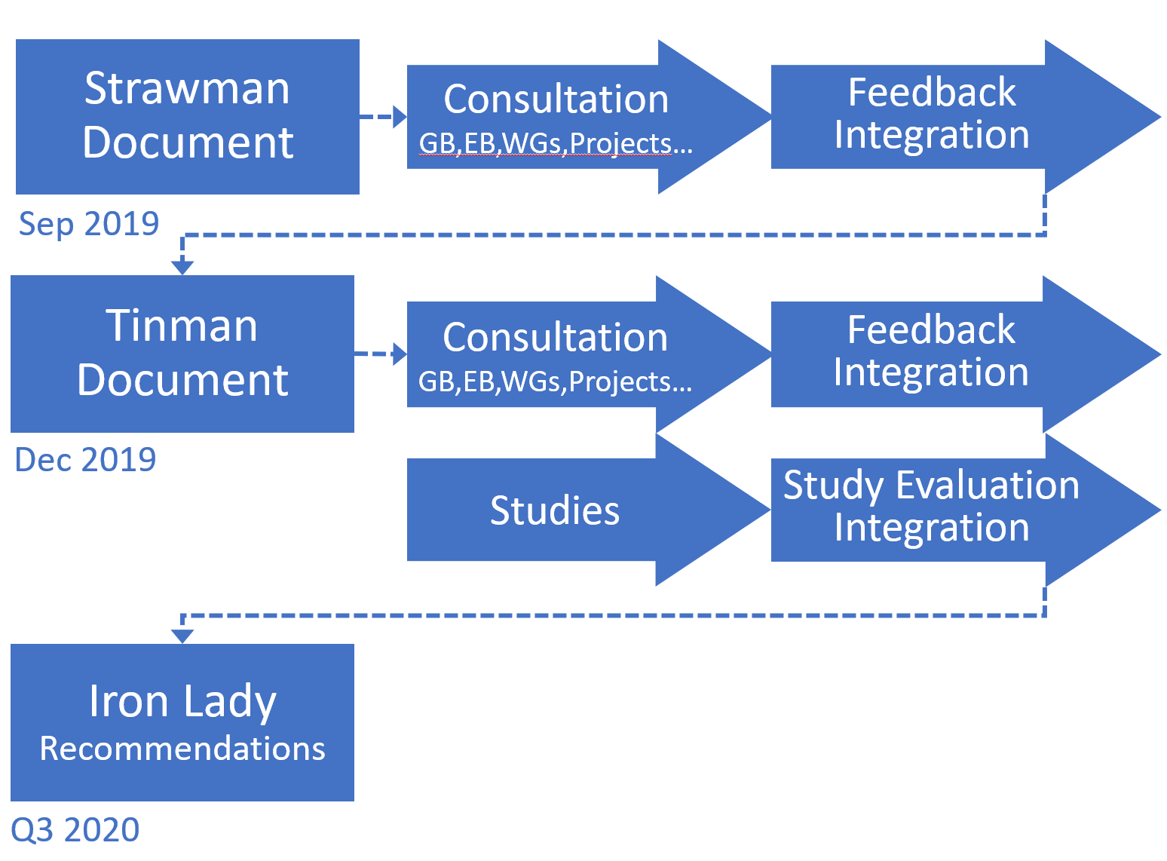
Work Process of the Sustainability Working Group
Identifying recommendations for EOSC post-2020 sustainability, i.e. business models, legal entity options, governance, national policy issues
Strawman – Tinman – FAIR Lady (Iron Lady)
Iterative approach & gradual growth of EOSC
Establish a Minimum Viable EOSC (MVE)
To enable federation of existing and planned research data infrastructures and additional services for publicly-funded research
Further iterations to include additional services for public sector and industry
Studies on legal entity, business models …

Slide 8

WG synergies and contributions to the FAIR Lady (Iron lady)
Studies
Legal and strategic advice on EOSC legal entity : Kellen Group
Landscape WG
EOSC-core operational costs: AcrossLimits and BoundaryLess
Rules of Part. WG
Strengthening of the EOSC Risk Governance : AON Hewitt
Architecture WG
Expanding EOSC: Industry Commons Foundation
Assessment Country Sheets Analysis: Digital Curation Centre
FAIR
WG
Theatrical release poster by Bill Gold
original illustration by Bob Peak
FAIR forever: Long Term Data Preservation: Digital Pres. Coalition

Slide 9
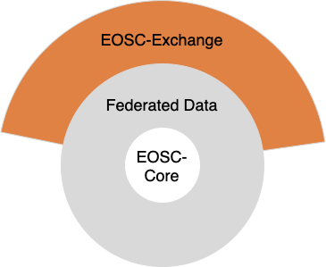
First iteration – a Minimum Viable EOSC (MVE)
Establish an initial MVE that will enable the federation of existing and planned research data infrastructures
MVE includes EOSC-Core and EOSC-Exchange which work with federated FAIR datasets
Main focus and added value: connect disciplinary infrastructures and enable cross-disciplinary research
Federation of research data infrastructures into EOSC via ​the cluster and regional projects as a critical first step

Slide 10
EOSC-Core services
Agreed with FAIR & Architecture WGs
Shared open science policy framework, which effectively embeds a data compliance framework for open / FAIR data. It defines and applies the rules of how the data elements are published, shared and re-used.
An instantiation of the EOSC interoperability Framework including
Authentication and Authorization Interoperability (AAI) framework,
Persistent Identifiers framework: Services to generate, resolve and validate persistent identifiers (PID)
Interoperable metadata framework: Within & between discipline interoperability
Data access framework, whose primary role is to offer data as a service. It enables open interfaces where data consumers (users and machines) are able to discover and use data.
Service management and access framework, consistent and agreed upon understanding of e-science services: what they offer, which science problem they address, what operational capacity, how accessed, who pays.
Open metrics framework, which sets the rules (usage, performance, value for money, user satisfaction) for the assessment of EOSC elements, i.e., policies, access framework, services, data, business, funding and usage models.
Security policies and procedures to ensure consistent and coordinated security operations across the federated services. This will include incident response policies and a service request and problem management scheme
Operational support services for EOSC-Core and made available to those federating services connecting to the EOSC-Core.
Web-portal including web-content as well as supply and demand facing services providing for accessing the EOSC resources.

Slide 11
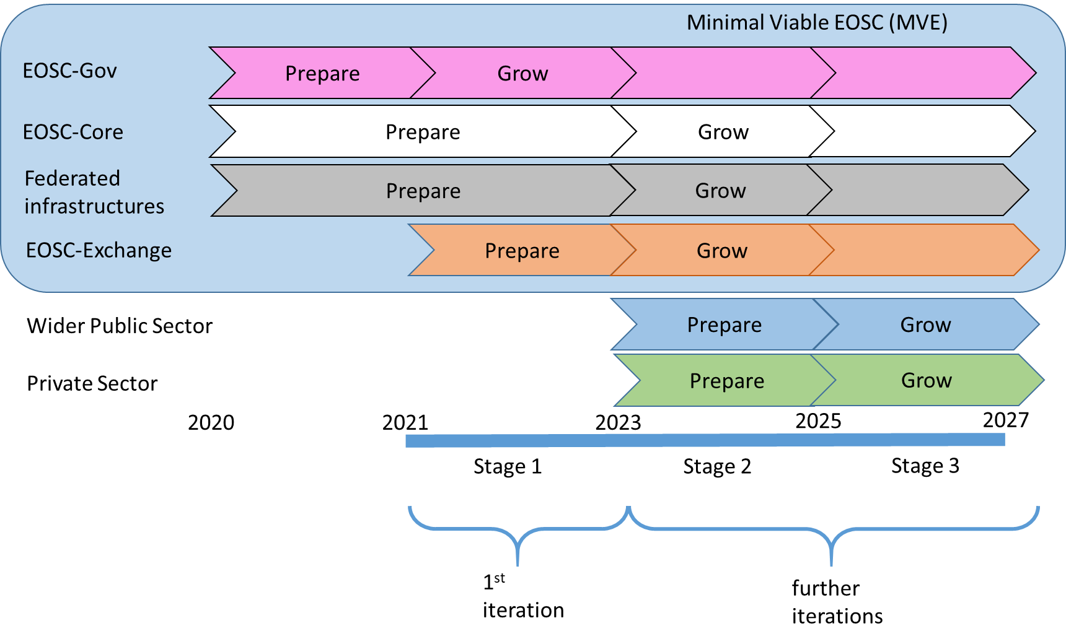
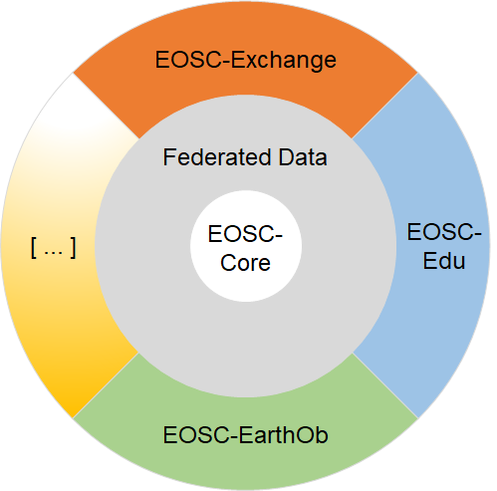
EOSC implementation: Structure, iterative process & timelines

Slide 12
Widening EOSC to public and private sectors – the PaNOSC use case
Sustainability WG launched study - Options to expand EOSC to the public and private sectors
Conducted by Industry Commons Foundation funded by Co-creation budget
Collected 23 use cases
PaNOSC use case
PaNOSC value-added SME application for industry/commercial use
Large volumes of data generated by the photon and neutron laboratories gathered together under the PaNOSC umbrella
Technical challenge to create software as a service (SaaS) allowing industry to apply the new knowledge created in the research environment.
Vision: a SME with the commercial incentive to provide this bridge would be able to provide such an innovative service solution

Slide 13
The big picture
The EOSC vision is not limited to linking datasets, federating infrastructures, or aligning policies
It links stakeholders throughout the data lifecycle and across the European research ecosystem
EOSC must be inclusive and supplement the activities of research communities
Divergence across and within stakeholder groups about the benefits and costs of EOSC as well as the disruption it may cause to existing structures, decision making processes and funding models
EOSC must acknowledge that such tensions exist and work to reconcile them
An iterative approach is needed to progressively build trust and resolve conflicts between the stakeholders while acknowledging that not all the solutions and answers are known today
There must be an objective assessment of what has been achieved with each iteration
The creation of the EOSC Association is an important achievement and it could provide a forum where the stakeholders resolve their differences and confirm their commitment to EOSC

Slide 14
Summary
The Minimum Viable EOSC (MVE) will enable the federation of existing and planned research data infrastructures for the benefit of publicly funded researchers accessing openly available FAIR data.
The MVE is necessary in order to establish an initial implementation of EOSC that brings value to users beyond their current use of infrastructures.
Draft Iron lady / FAIR lady document now available via EOSC liaison platform https://www.eoscsecretariat.eu/system/files/solutions_for_a_sustainable_eosc_-_ironlady_draft_19oct20.pdf

Slide 15
THANK YOU
ANY QUESTIONS?

Slide 16
EOSC as a European Strategic Partnership with the EC
EOSC foreseen to enter into a co-programmed European Strategic Partnership
provide a long-term funding mechanism for strategic development of EOSC
shape strategic alignment of policies and set common standards through a common Strategic Research and Innovation Agenda (SRIA)
EC funding expected to match partnership-based commitments by EU Member States & Associated Countries; mainly be “in-kind”, data, services …
MoU between EC and EOSC Association
Association currently being set up to be operational by Dec 2020 to sign the MoU with the EC
Association comprised of EOSC partner organisations
Association Core Tasks: SRIA, Standards, Monitor, Community Dialogue, Helpdesk, Training …
Strategy Committee MS/AC
European Commission
EOSC Association
Partnership Board
(EC, Board & Strategy Committee)
General Assembly
Board
President
MoU
Secretary General
Commission funding through work programme
Contributions by MS / AC and others (in kind; data, services, …)

Slide 17
Co-Programmed EOSC Schematic Diagram
Strategy Board MS/AC
National funder
Member states @ relevant Programme Committee amend and agree Work Programme with EC Comitology
Work Programme passes through Inter-service Consultation and is finalised and published by EC
RI Work Programme
EOSC Association
Commercial service provider
General Assembly
Board
President
Association budget for additional service
Project Y
Topic B
Project X
Topic A
Project Z
Topic C
Secretary General
Co-create draft EOSC Work Programme with EC / SRIA
EOSC CORE
EOSC Exchange
MVE
Office functions
Core service
Thematic service
EOSC service
EOSC service
EOSC service
Community Dialogue
Standards
Core service
PID
Helpdesk

Slide 18
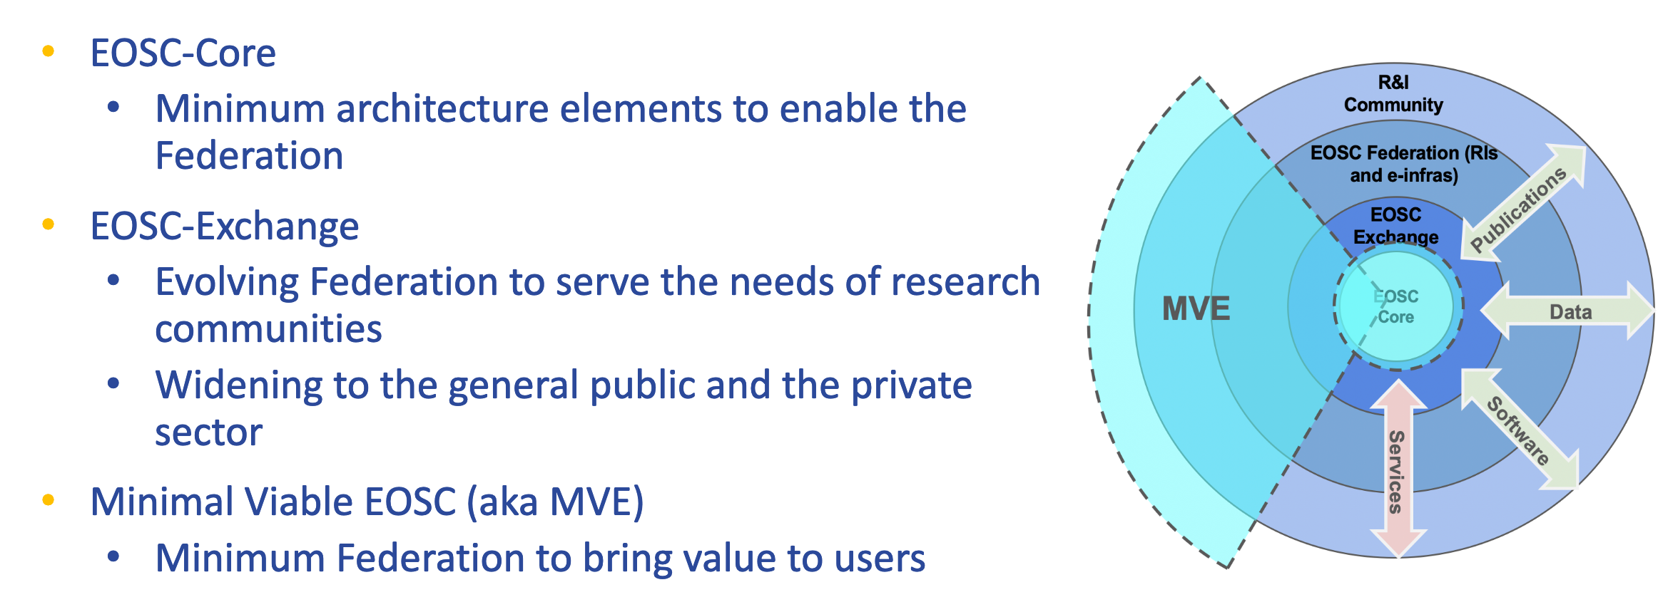
EOSC (M)architecture

